Slide 1

Causal AI 信息视角下因果理论
@Tsinghua KEG
https://sites.google.com/view/minituring/
Heyang Gong
zj3712@gmail.com
@University of Science and Technology of China
欢迎前往 https://heyanggong.github.io/tangjieReport/ 项目详细了解更多详情和对应 github 上提 issues.
Notes:
对自己不熟悉的领域应该保持节制。

Slide 2

Causal AI: 信息视角下因果理论
人工智能简介
因果革命
信息因果模型
Causality as Information transfer
do intervention & info intervention
Info Causal Models
思考和展望 CausalAI

Slide 3

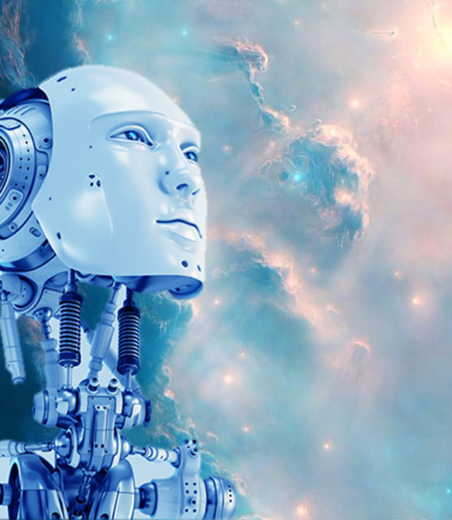
人工智能简介

Slide 4
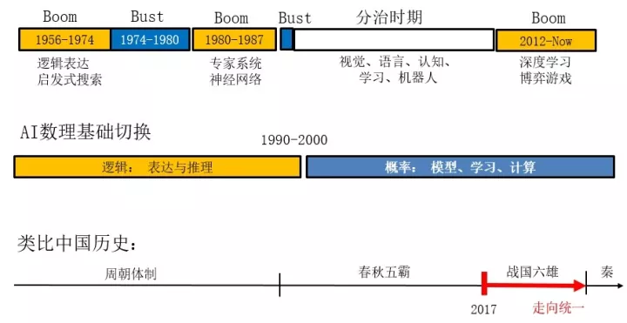
历史
参考： 浅谈人工智能：现状、任务、构架与统一 | 正本清源 by 朱松纯

Slide 5
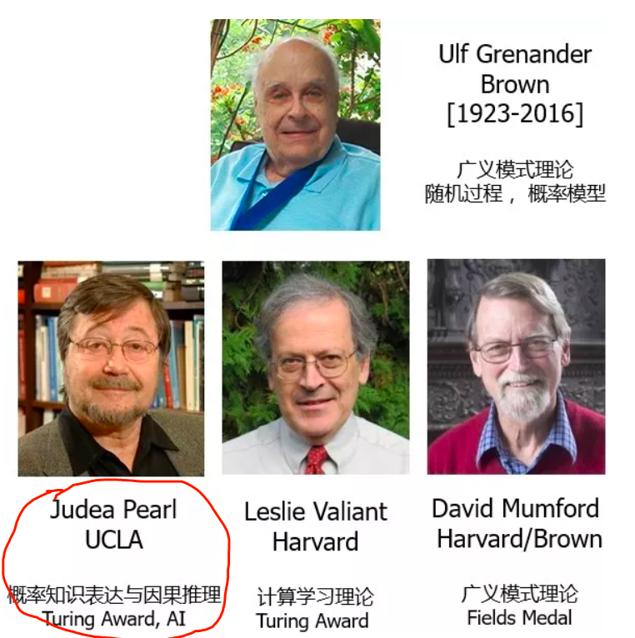
两个阶段
第一阶段：前30年以数理逻辑的表达与推理为主。这里面有一些杰出的代表人物，如John McCarthy、Marvin Minsky、Herbert Simmon。他们懂很多认知科学的东西，有很强的全局观念。
第二阶段：后30年以概率统计的建模、学习和计算为主。在10余年的发展之后，“春秋五霸”在1990年中期都开始找到了概率统计这个新“体制”：统计建模、机器学习、随机计算算法等。在这个体制的转型过程中，起到核心作用的有这么几个人:

Slide 6
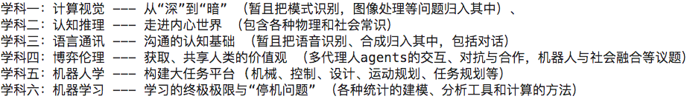
六大领域的因果诉求
例如 CV 中用于几何常识推理与三维场景构建的时空因果的解译图(STC-PG)，博弈伦理中 Agents 需要一个关于世界的因果模型等等。
It is no secret that causality is one of the major shortcomings of current machine learning systems

Slide 7
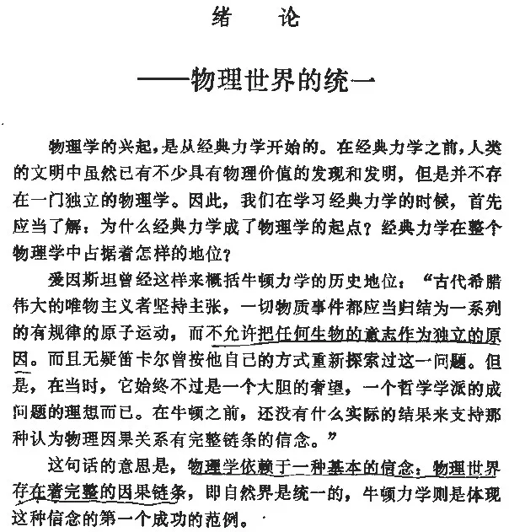
物理世界存在着完整的因果链条
因果律不变性(relativity)
现在因果理论就是两种比较流行 “law-like” causality and interventionalist causality .

Slide 8
Causal AI: 信息视角下因果理论
人工智能简介
因果革命
信息因果模型
Causality as Information transfer
do intervention & info intervention
Info Causal Models
思考和展望 CausalAI

Slide 9

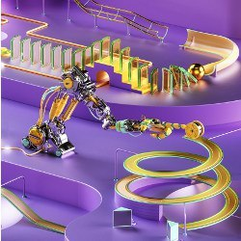
Pearl's 因果革命
强人工智能三大困难
三级因果思维
七个因果任务
小图灵测试
I aim to describe to you how robots can be constructed that learn to communicate in our mother tongue—the language of cause and effect. This new generation of robots should explain to us why things happened, why they responded the way they did, and why nature operates one way and not another. More ambitiously, they should also teach us about ourselves: why our mind clicks the way it does and what it means to think rationally about cause and effect, credit and regret, intent and responsibility. —The Book of Why, Preface

Slide 10
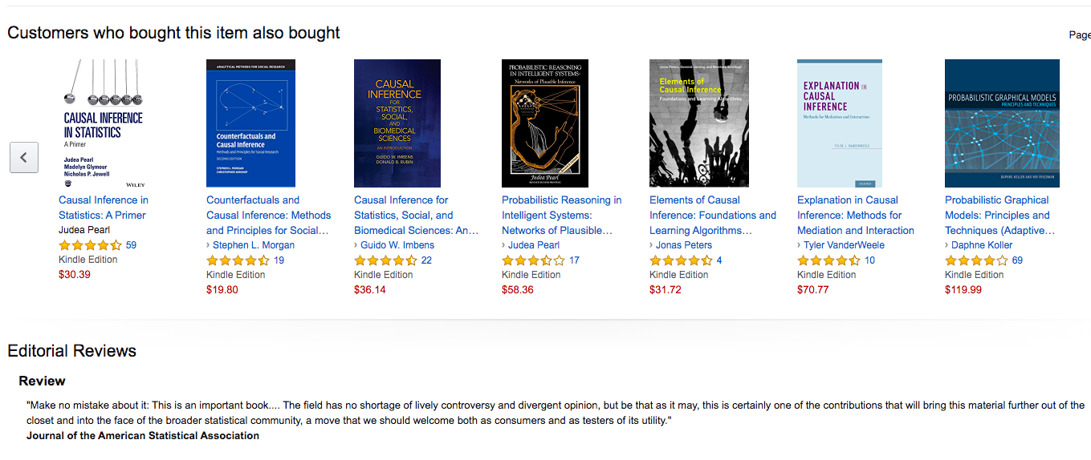

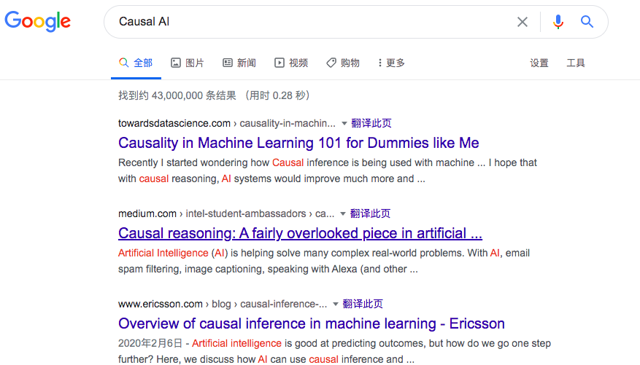

The dramatic success in machine learning
Notes:
在微软的朋友问我有关异常诊断的问题。因果推理开始用了
Uber 开发 Pyro 的目的，和美团类似吧，需要做概率推理。
阿里文娱的 AAAI2020 tutorial,

Slide 11

Why should we care about causality? We have increasing amounts of data and highly accurate predictions. How is causal inference useful?

Slide 12
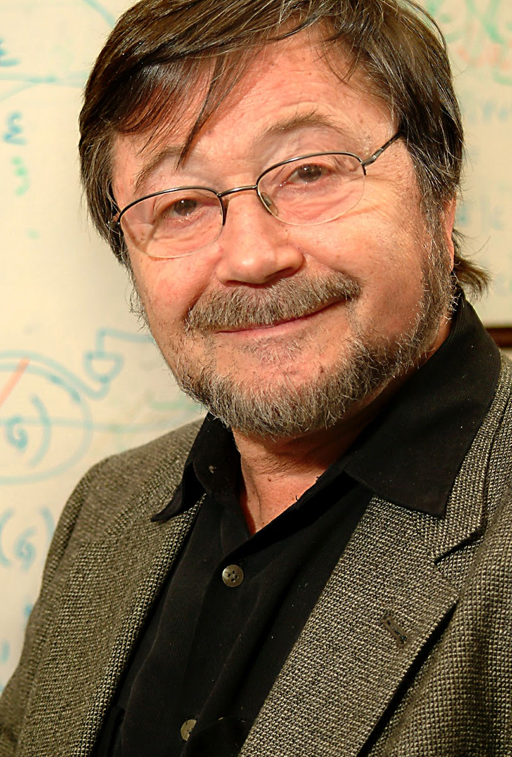
Judea Pearl
Causality (2009)
The Book of Why (2018)
J. Pearl, "Causal and counterfactual inference,"
J. Pearl, "The Seven Tools of Causal Inference with Reflections on Machine Learning,"

Slide 13
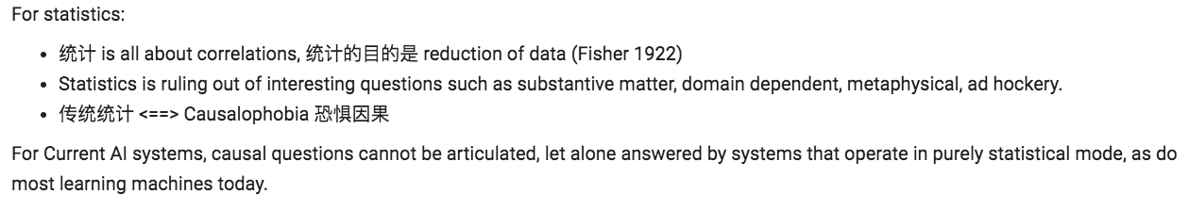
Pearl 同时是 AI 和 Statistics 最激烈的批评者
从统计和机器学习的关系，反思数据科学，指出未来方向
因果推断的七个步骤
Notes:
这里讲讲，我为什么离开了传统统计，走向了AI研究。郁彬老师的跨学科。
同时批判统计和AI，但是同时是统计和AI的教授。
七个步骤，文章被盗，没有署名。。。。, Donanld B Rubin 最多引用量
Rethinking statistics https://fehiepsi.github.io/rethinking-pyro/

Slide 14

强人工智能的三大困难
The dramatic success in machine learning has led to an explosion of artificial intelligence (AI) applications and increasing expectations for autonomous systems that exhibit human-level intelligence. These expectations have, however, met with fundamental obstacles that cut across many application areas(六大领域).

Slide 15
Three main obstacles
The Lack of Understanding Cause-effect Connections
Robustness or Adaptability
Explainability

Slide 16
Causal AI 大势所趋
Bernhard Scholkopf, Causality for Machine Learning
Yoshua Bengio, System 2 deep learning: The next step toward artificial general intelligence
Hector Zenil, Causal deconvolution by algorithmic generative models
Peng Cui, Causal Inference and Stable Learning
Gary Marcus, Rebooting AI: Building Artificial Intelligence We Can Trust
Notes:
https://www.robust.ai/

Slide 17


All three obstacles can be overcome using causal modeling tools, in particular, causal diagrams and their associated logic! --- by Judea Pearl 因果模型所处理的信息远远超出统计模型，包含了 Lorenzian imagined space 中的数据信息。
Notes:
Thinking is acting in imagined space.

Slide 18
三级因果思维
Causal questions cannot be articulated, let alone answered by systems that operate in purely statistical mode, as do most learning machines today.

Slide 19
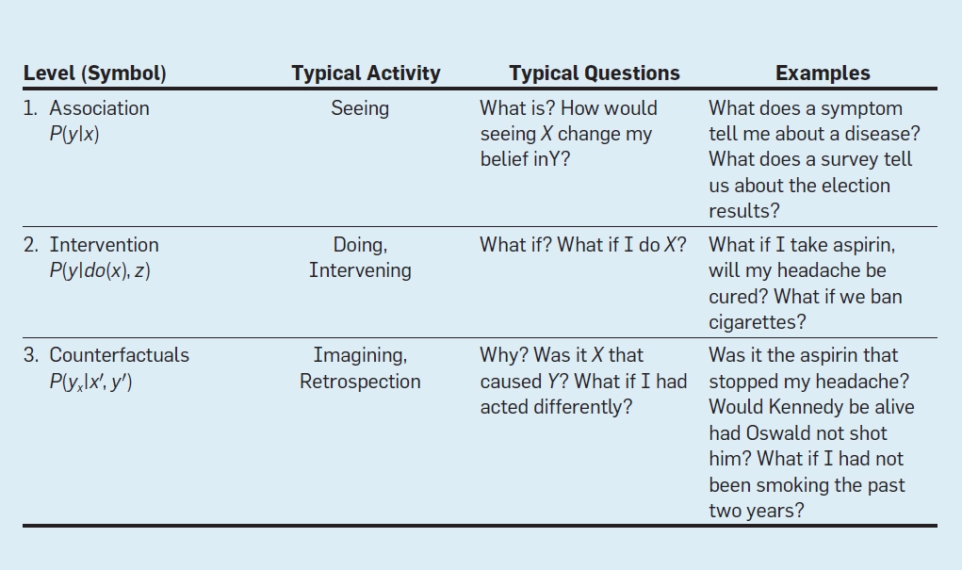

Slide 20
Causal Questions
How effective is a given treatment in preventing a disease?;
Was it the new tax break that caused our sales to go up?;
What annual health-care costs are attributed to obesity?;
Can hiring records prove an employer guilty of sex discrimination?; and
I am about to quit my job, but should I?

Slide 21
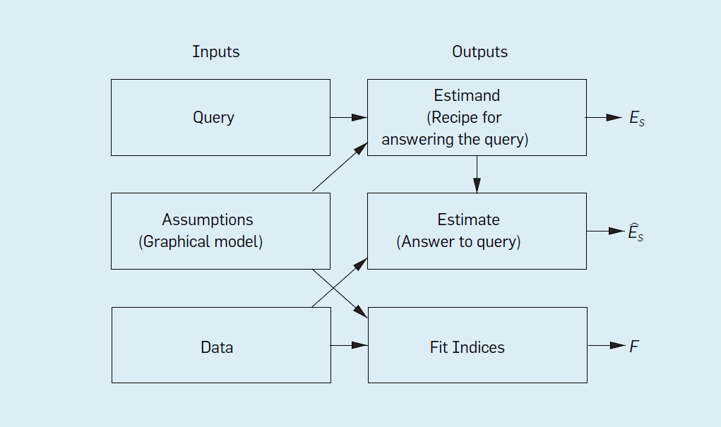
The Form of an Inference Engine
Notes:
因果推断关注的是 debias, 意味着正确回答问题, 也就是 stable learning.

Slide 22

Mini Turing Test
How can machines represent causal knowledge in a way that would enable them to access the necessary information swiftly, answer questions correctly, and do it with ease, as a human can?

Slide 23
Causal AI
教会机器因果推理
通过小图灵测试
Notes:
一个 AI 要拥有思考能力和真正智能，它至少包括3个组成部分：
1. 关于世界的因果模型；
2. 关于自身和环境交互因果模型，无论这个模型有多浅显；
3. 以及一个记忆系统，用于记录其自身意图和外部事件的对应关系。

Slide 24
因果推断七大任务
A bird's-eye view of seven tasks accomplished through the SCM framework and the tools used in each task and discuss the unique contribution each tool brings to the art of automated reasoning.

Slide 25
Seven Tools of Causal Inference
Encoding causal assumptions: Transparency and testability.
Do-calculus and the control of confounding.
The algorithmitization of counterfactuals.
Mediation analysis and the assessment of direct and indirect effects.
Adaptability, external validity, and sample selection bias.
Recovering from missing data.
Causal discovery.

Slide 26
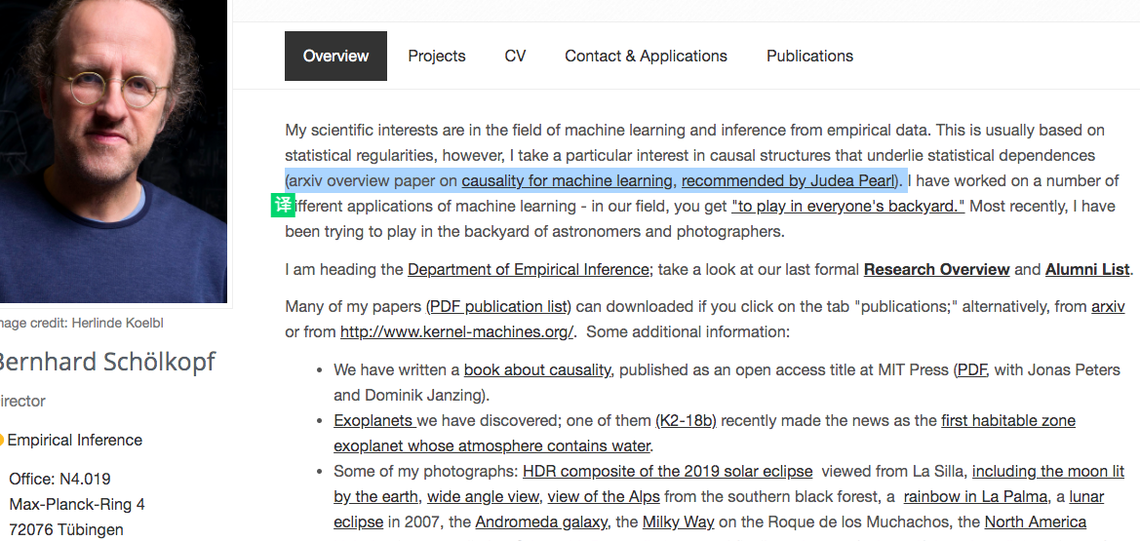
Recommended by Judea Pearl

Slide 27
信息革命
马克斯·普朗克智能系统中心主任 Bernhard Schölkopf 发表论文，谈论了因果关系和机器学习之间的联系，并科普了一些相关的重要概念。Judea Pearl 转发相关推文，表示”这是一篇非常全面、令人愉悦且极具启发性的论文，适合所有人，而不仅仅是机器学习以及人工智能从业者阅读。
该论文第二个章节关于信息革命的内容最具备启发性，因果模型需要融入信息论视角
How can machines represent causal knowledge in a way that would enable them to access the necessary information swiftly, answer questions correctly, and do it with ease, as a human can?
Notes:
需要优秀的人一起来深入研究 Bernhard 的工作。
Causal disentanglement is the next frontier in AI
他的相关论文 https://colab.research.google.com/drive/1TRATVYkJIt7rvOs-G9wHejCz1i70pQz-

Slide 28
Causality for Machine Learning
Invariance, Robustness, and Semi-Supervised Learning
Semi-supervised learning (SSL), anti-causal questions(手写数字识别)
Adversarial vulnerability， Non IID data
Multi-task learning
Reinforcement Learning
Causal Representation Learning
Learning transferable mechanisms
Learning disentangled representations
Learning interventional world models and reasoning
Notes:
解决因果问题”：有没有更具体的方向和议题呢？
一个是 Scholkopf, Bengio 在做的 causal representation learning, system 2 deep learning
另外一个难题需要解决的是 cyclic causal models, 现在的因果模型很好的模拟 feedbacks，太弱了

Slide 29
Causal AI: 信息视角下因果理论
人工智能简介
因果革命
信息因果模型
Causality as Information transfer
do intervention & info intervention
Info Causal Models
思考和展望 CausalAI
Notes:
两个最重要的事情，
介绍因果的数学化
我们的研究就是从信息视角对因果数学化

Slide 30
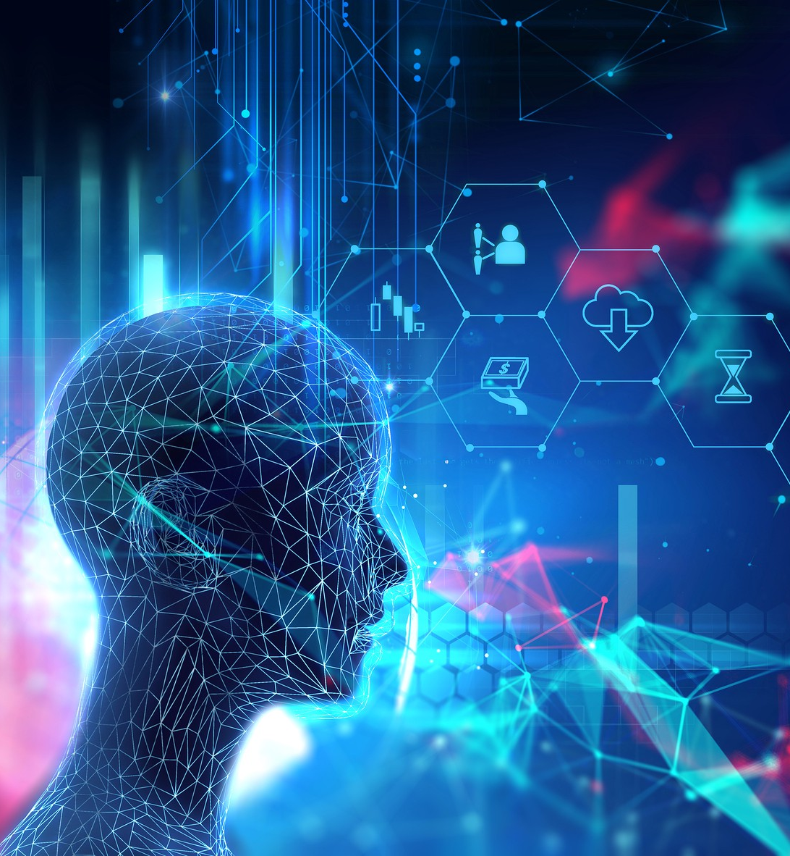
信息因果模型
Causality as Information Transfer
Do intervention & info intervention
Info Causal Models

Slide 31
Causality as Information Transfer

Slide 32
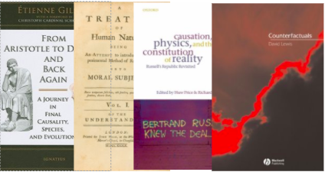
What is Causality?
A big scholarly debate, from Aristotle to Russell

Slide 33
What is Causality?
A fundamential question
现在两种比较流行因果理论就是: “law-like” causality and interventionalist causality .
Surprisingly, until very recently---maybe the last 30+ years---we have not had a mathematical language of causation. We have not had an arithmetic for representing causal relationships.
"More has been learned about causal inference in the last few decades than the sum total of everything that had been learned about it in all prior recorded history"
--- Gary King, Harvard University
Notes:
因果是格式塔
Law-like causality
Interventionism
Mental causation
因果的数学语言。

Slide 34
A Practical Interventionist Definition
Definition: T causes Y iff
changing T leads to a change in Y,
keeping everything else constant.
The causal effect is the magnitude by which Y is changed by a unit change in T.
Called the “interventionist” interpretation of causality.
Interventionist definition 参见：http://plato.stanford.edu/entries/causation-mani/

Slide 35
A Practical Definition in Information View
Definition: T causes Y iff
Changing information on T leads to a change in Y,
keeping everything else constant.
The causal effect is the magnitude by which Y is changed by a change of information on T.
Causality as Information transfer!
Collier, J. D. (1999). Causation is the transfer of information. In Causation and laws of nature (pp. 215-245). Springer, Dordrecht.
Bernard Feltz, Marcus Missal, and Andrew Sims. Free will, causality and neuroscience
Notes:
- 近三十年，因果研究开始使用数学，哲学家已经开始重视 Causality as information transfer, 但是数学上还没有行动，没有 info causality 的数学语言，我就是这个行动。
什么是信息？数学上来说？既然是数学化，问问其他人关于信息数学上的定义。
A “model” is an idealized representation of reality that highlights some aspects and ignores others.

Slide 36

Keeping everything else constant: Imagine a counterfactual world
“What-if” questions
Reason about a world that does not exist.
Konrad Lorenz's imaged space
What if a system intervention was not done?
What if an algorithm was changed?
What if I gave a drug to a patient?
Notes:
Thinking is acting in imagined space.

Slide 37
为什么信息因果 A “model” is an idealized representation of reality that highlights some aspects and ignores others.
Causality, free will and neuroscience
Mini Turing Test
信息革命
万物皆量子比特
Causal deconvolution
大脑信息处理
Notes:
信息的本书是什么？
- The analogy between energy and information is compelling, but our present understanding of information is rather
incomplete, Scholkopf 承认。他也尝试 Among fundamental physicists, it is widely held that information should
also be a conserved quantity。他想有一个 a unified concept of information.
- 信息是可能比能量更基础的量，所以把因果理解成信息传递有其合理性。
2004年7月21日，在爱尔兰都柏林举行的“第17届国际广义相对论和万有引力大会”上，英国传奇科学家斯蒂芬·霍金教授宣布了他对宇宙黑洞的最新研究结果，霍金的态度来了个180度转弯，表示自己原来的观点错了，信息应该守恒：黑洞并非如他和其他大多数物理学家以前认为的那样，对其周遭的一切“完全吞食”，事实上被吸入黑洞深处的物质的某些信息实际上可能会在某个时候释放出来：信息守恒。
信息守恒原理和能量守恒原理一样，是自然中非常重要的一个原理。信息守恒原理是指宇宙中的全部信息（含虚信息）是守恒的，不管宇宙如何演化，它们既不会增加，也不会减少，而是保持一个恒定的值。那么这个值是多少呢？答案：无限多。信息是宇宙中的三大要素之一（其它两个为物质、能量）。宇宙中任何存在都离不开这三种要素的存在。信息可以在三种模型之间转化，这三种模分别是：1.实体模型（一切实体模型都携带了信息和虚信息）；2.信息模型；3.虚信息模型。
只仔细讲讲第一个，后面的稍作提及
-

Slide 38
Causal AI: 信息视角下因果理论
人工智能简介
因果革命
信息因果模型
Causality as Information transfer
do intervention & info intervention
Info Causal Models
思考和展望 CausalAI

Slide 39
Do Intervention & Info Intervention

Slide 40
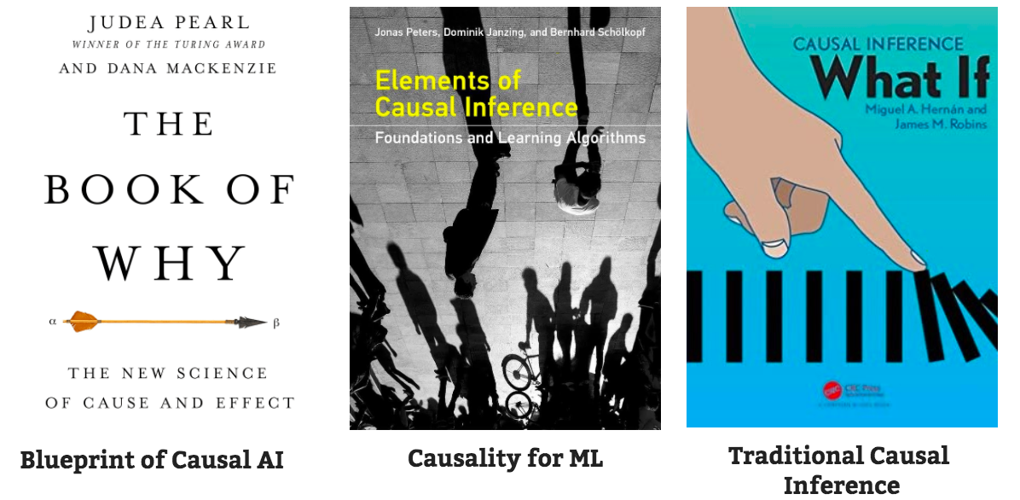
Books for Causal Inference

Slide 41
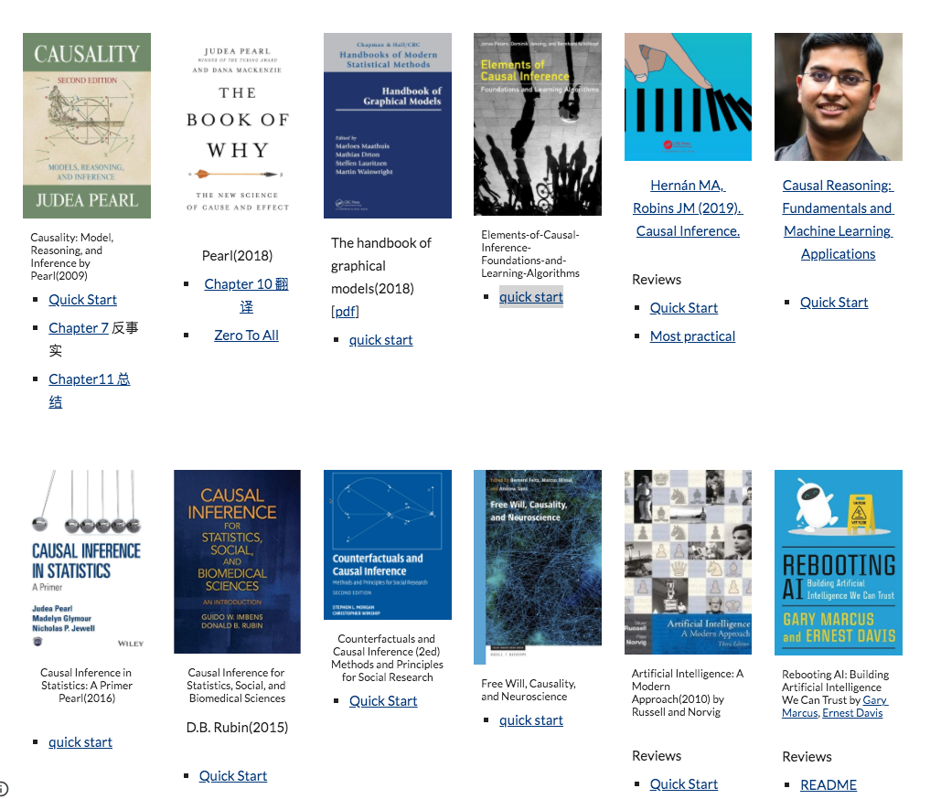

Slide 42
Seeing VS Doing
do-calculus. This do-intervention is called an atomic intervention as it affects a single variable that is being set to a specific value.
Potential Outcome Framework
Regime indicator. It consider the above 'seeing' and 'doing' as two types of regimes, a natural one and a set of interventional ones.

Slide 43
Potential Outcomes Framework
Potential outcomes reasons about causal effects by comparing outcome of treatment to outcome of no-treatment
For any individual, we cannot observe both treatment and no-treatment.
Randomized experiments are one solution

Slide 44
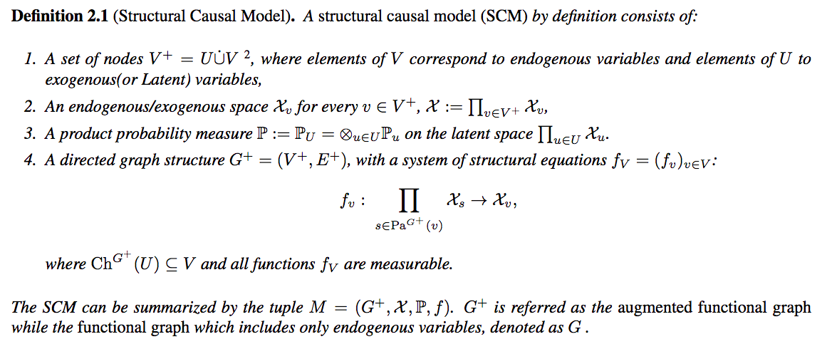
结构因果模型(SCMs)

Slide 45
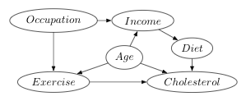
Problems of do intervention
A do intervention which forces some variable to a given value is somewhat idealized or hypothetical.
do(X < x) 如何定义？
Cyclic Causal Diagrams 的理论困难
参见：
On the Interpretation of do(x) ， Judea Pearl(2019)
Theoretical Aspects of Cyclic Structural Causal Models Bonger(2016)

Slide 46
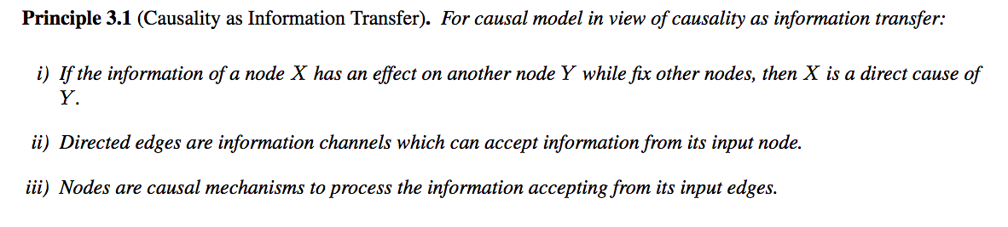
信息因果建模原则
From do intervetion to info intervention!

Slide 47
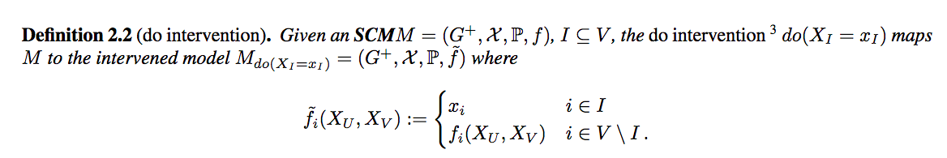
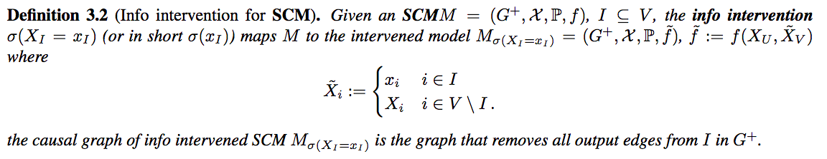
信息干预 VS 动作干预

Slide 48
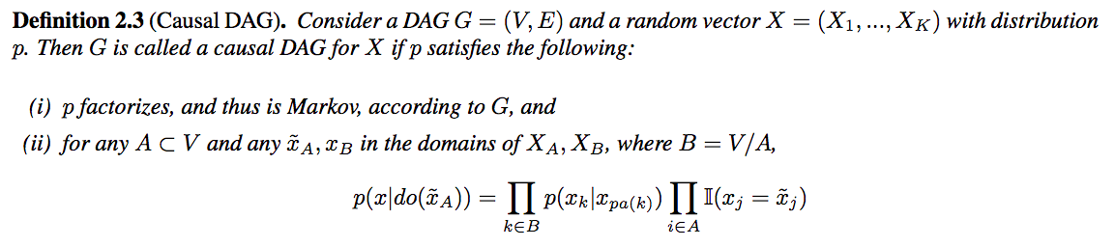
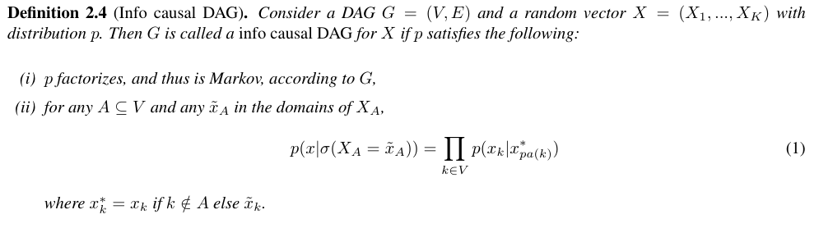
Causal DAG VS Info Causal DAG

Slide 49
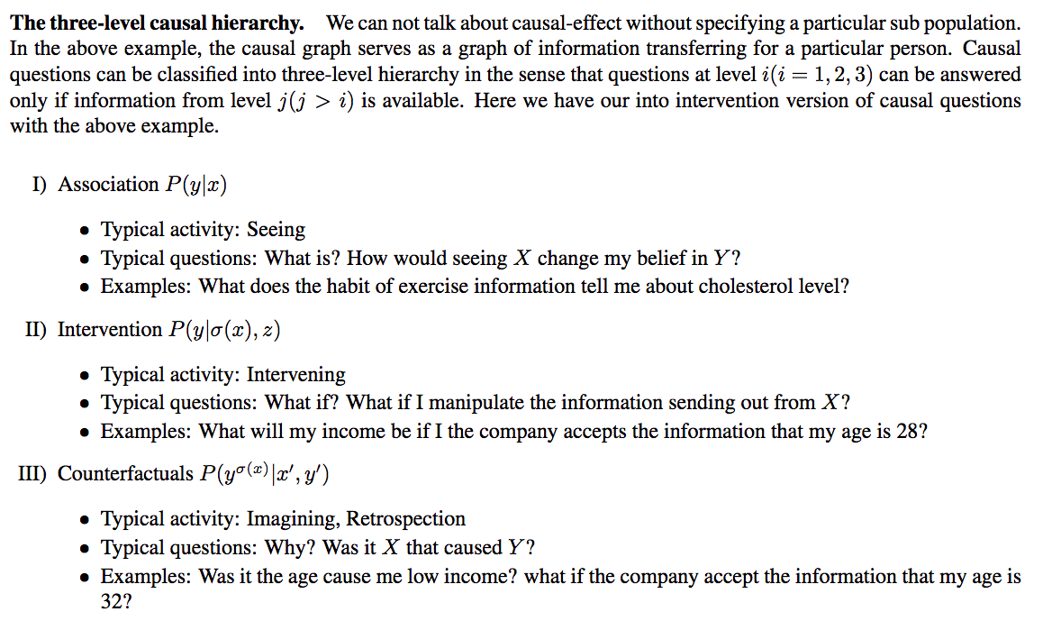
Causal Queries

Slide 50
Causal Calculus
How can machines represent causal knowledge in a way that would enable them to access the necessary information swiftly, answer questions correctly, and do it with ease, as a human can?
Pearl’s 3 rules for do intervention enables us to identify a causal query(articulated by do operator), turn a causal question into a statisitcal estimation problem.
How to identify a causal query articulated by info intervention?

Slide 51
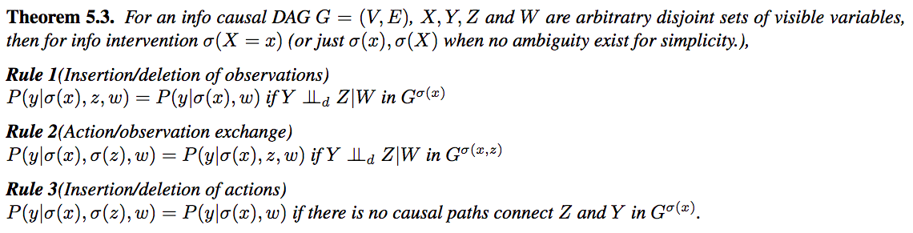
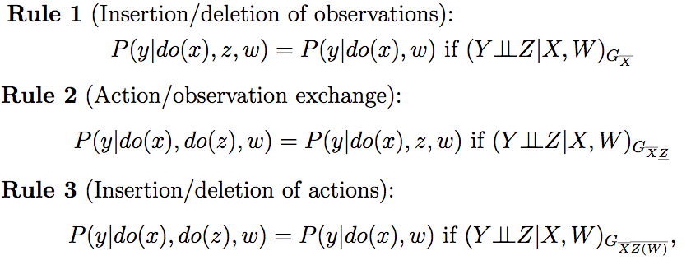
Causal Calculus

Slide 52
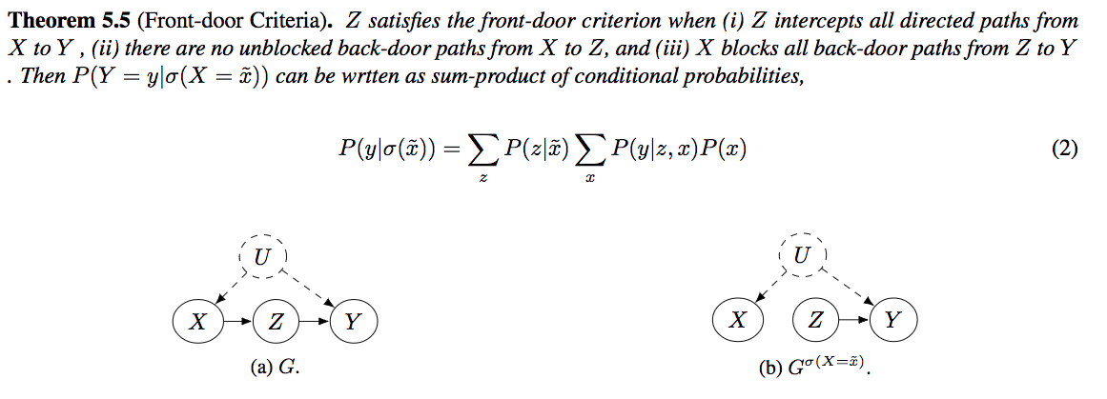
Front-door Criteria

Slide 53
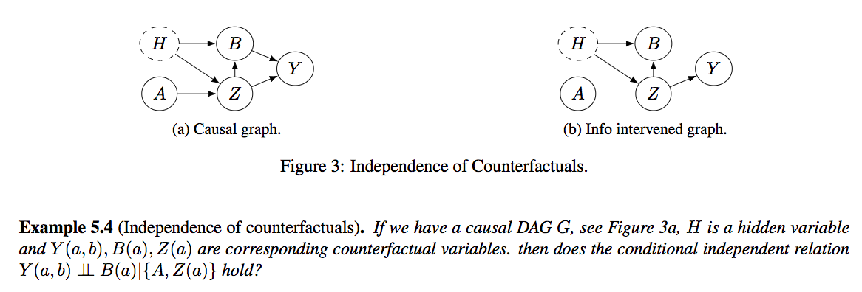
Independence of Counterfactuals

Slide 54
Causal AI: 信息视角下因果理论
人工智能简介
因果革命
信息因果模型
Causality as Information transfer
do intervention & info intervention
Info Causal Models
思考和展望 CausalAI

Slide 55
Info Causal Models

Slide 56
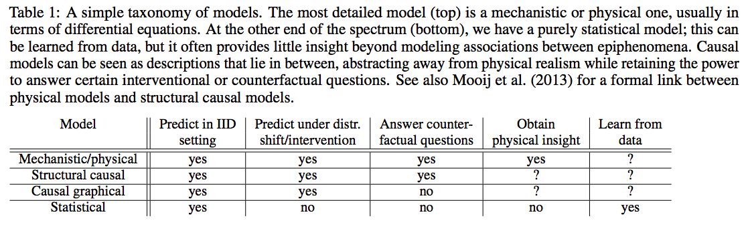
Levels of Causal Modeling
Law-like causality
interventionism causality,
information causality(or mental causation, causal exclusion problem)
Notes:
因果图模型一般是有向无环图，可以回答反事实问题，但是有环图的时候不行。当前社区是想用 SCM 来回答，但是这会出现问题。

Slide 57
两个主要困难
因果图未知
有环因果图
Causal Discovery, (Zhu, 2020)
Causal representation learning (学习因果变量，system 2 deep learning)
Learning disentangled representations
Feedbacks as equilibrium by Lauritzen(2002)
有环SCM数学框架 by Bonger(2016)
当前大多数关注的都只是 Causal DAGs!
Notes:
例如 Song-Chun Zhu 团队的文章 Decomposing human causal learning: Bottom-up associative learning and top-down schema reasoning 2019 中使用的就是 DAG 。

Slide 58
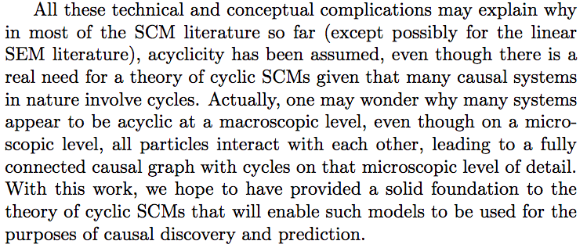
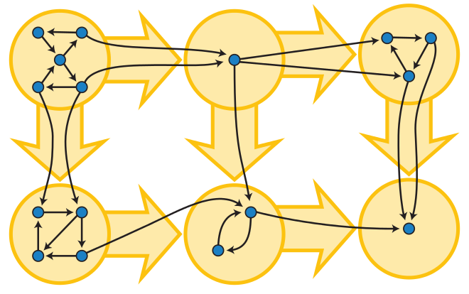
Dead Ends!

Slide 59
Causality as Information Transfer

Slide 60
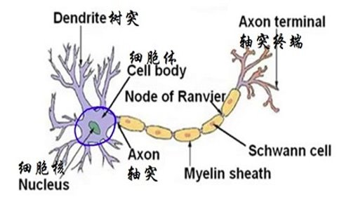
信息因果建模原则
Notes:
Independent causal mechanisms principles.

Slide 61
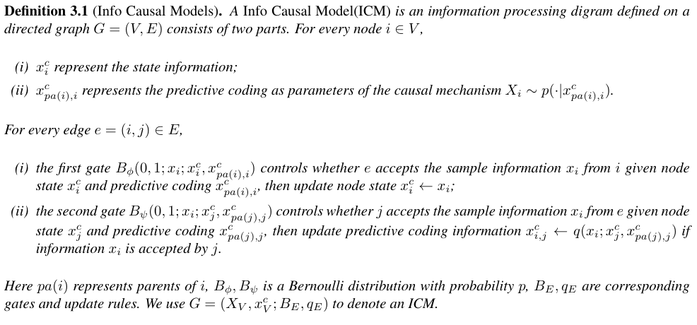

Slide 62
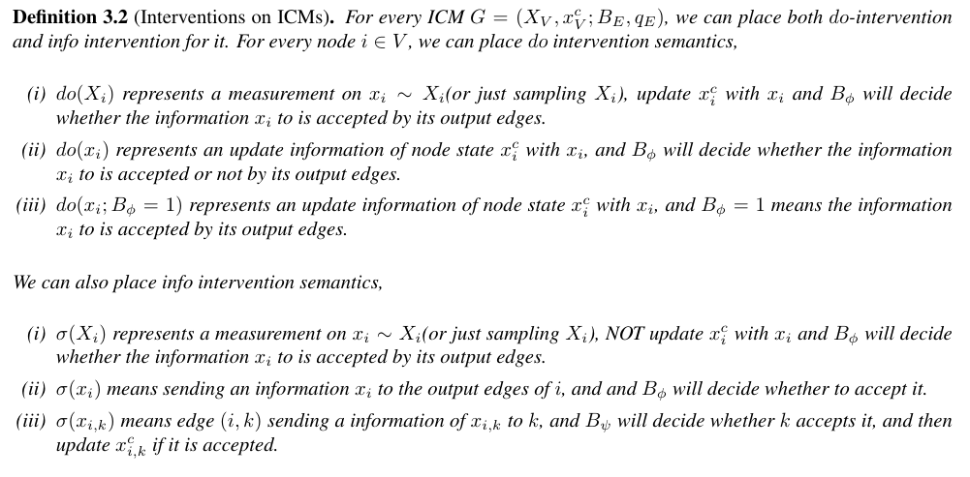

Slide 63
为什么？有什么好处？
A “model” is an idealized representation of reality that highlights some aspects and ignores others.
Prons:
基于信息因果的模型
干预不在具备可交换性，具有完备的因果语义
每个样本代表一个依赖于图结构和数据的随机信息传递过程
Cons:
模型过于复杂，难以训练
Use PPL (e.g. Pyro)
Notes:
一个人有想法，也难以实现，这是非常致命的。不是在一个团队里面工作。
如果博士学位意味着，只要你花时间，你可以理解这个世界任何一种技术。那么我一直都有一种认知，那就是只有我花时间，我可以理解任何数学。
在因果研究这条路上，我的风格是遇到问题解决问题，需要代码学会代码每个困难都是自我提高的机会。
Pyro 是概率编程的 state-of-art.

Slide 64
Examples
Bayesian Networks
所有的门控都100% 通过
更新准则就是简单的替换
每个样本都是对根变量的动作干预产生
Variational Autoencoder
所有门控都100%通过
更新规则就是简单的替换
每个样本都是对潜变量的动作干预产生
Recurrent Neural Network
只有一个信息处理节点和一个输出节点，每个门控仅仅通过一次信号
更新准则不再是简单的替换
每个样本都是序列信息干预产生

Slide 65
如何解决有环问题？
把因果图中的用门控断开（例如 RNN）
每个样本代表一个依赖于图结构和数据的随机信息传递和处理过程

Slide 66
Causal AI: 信息视角下因果理论
人工智能简介
因果革命
信息因果模型
Causality as Information transfer
do intervention & info intervention
Info Causal Models
思考和展望 CausalAI

Slide 67

思考和展望 CausalAI

Slide 68
思路梳理
当前机器学习的成功让人们更加渴求强人工智能
强人工智能遇到了三大困难
参考当前已知的智能形式
基于信息的因果模型是关键

Slide 69
有哪些处理信息的智能？
Go bigger！
Go smaller！
蚁群，个人，公司，人类群体，地球？
计算机，大脑，细菌，神经元？

Slide 70

最强最熟悉的智能？
人类群体智能
类脑智能
人类是唯一大规模灵活协作的物种
人类具备使用反事实推理的能力。
神经元计算模型
Predictive coding
Notes:
话说我有个脑洞想估计一下类脑的人工智能的难度，我想的方法是用突触的数目和二极管的数目做个大概的比较（原因是都是基本非线性单元），查到的资料是人脑中神经元的数量级是900亿，突触数目是万亿级别的（听上去有点多？），然后我查了一下手机的二极管芯片数量不到100亿，如果按照这个方法估计的话，难度好像非常大
芯片我想到的关键词是分层和演化，神经元我想到的是分形，我也觉得可能现在芯片架构里面的层次化不如脑神经高明，重点确实在层次化结构上面

Slide 71
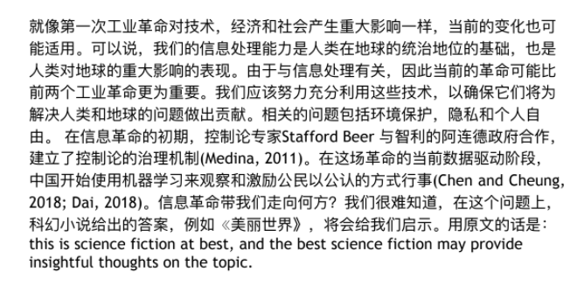
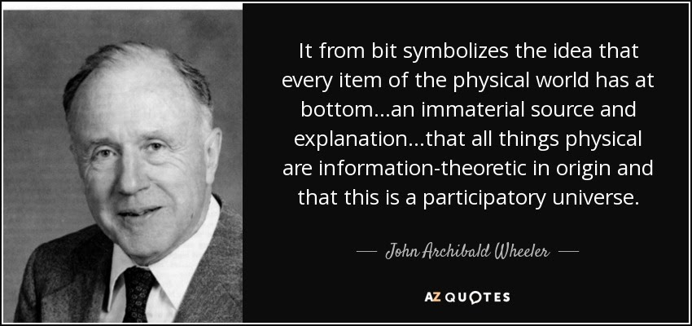
信息革命
群体智能是高效处理信息的系统
因果模型所包含和处理的信息远远超出统计模型
Decision, act and communicate in Lorenzian imagined space

Slide 72
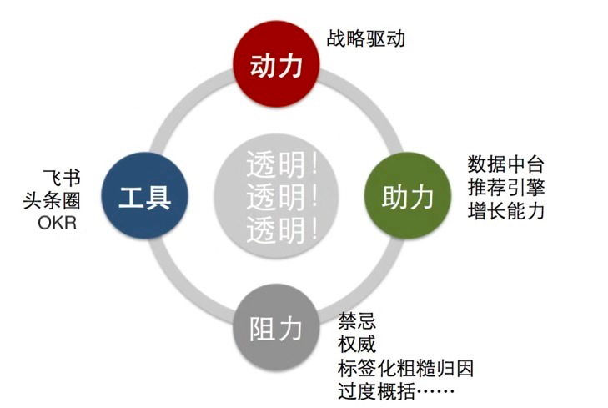
字节跳动的群体智能
第一条是入职筛人，字节跳动选的人，首先要有拥抱变化的心态。因为如果是追求稳定的心态，就会压制创新。
第二条是信息环境，尽最大可能让信息透明，尽量让多元声音发声，防止公司的信息环境扭曲。
第三条是协同网路，字节跳动选择用OKR来做目标对齐和管理的工具。整个字节跳动5万人，每个普通员工，都能看到张一鸣的OKR，看到老板在做什么，他的重点是什么。
而字节跳动为了降低创新阻力，为了避免信息扭曲，让创新涌现，搭建了一个在今天中国商业界，透明度最高的企业信息环境。

Slide 73
Mini Turing Test
How can machines represent causal knowledge in a way that would enable them to access the necessary information swiftly, answer questions correctly, and do it with ease, as a human can?
因果模型所包含的信息远远超出统计模型！

Slide 74
Causal AI
教会机器因果推理
通过小图灵测试
Notes:
Judea Pearl 认为因果推理能力是自由意志的关键。因果关系是否存在？
自由意意志一样是一种有用的幻觉，认知层面上是存在的，而在神经科学层面上是不存在。因果关系也是这样的？

Slide 75
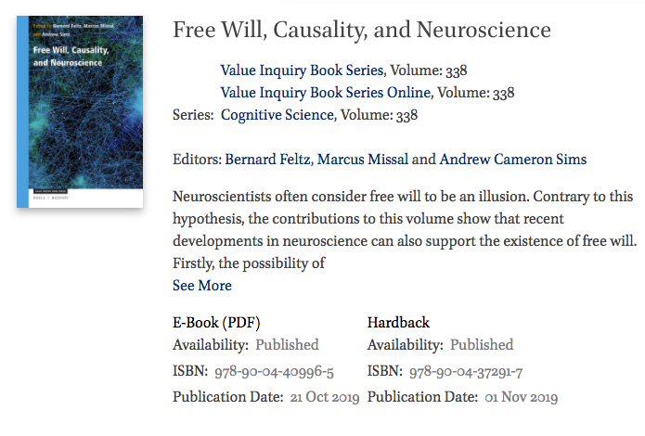
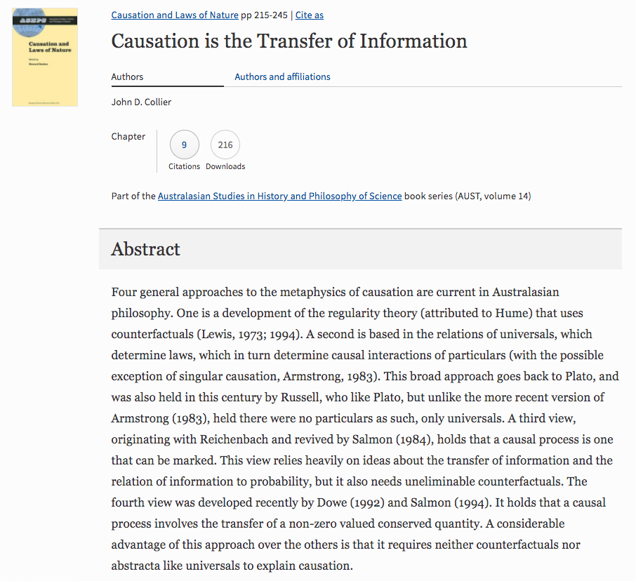
Causality as Information Transfer
Causal Exclusion Problem
听到门铃去开门的原因是门铃响了还是认为有人来了？
Law-like Causality
Interventionism Causality
Information Causality
Notes:
因果的形而上学 metaphysics，Four general approaches to the metaphysics of causation
One is a development of the regularity theory (attributed to Hume) that uses counterfactuals
A second is based in the relations of universals, which determine laws, Plato 到 Russell
A third view, originating with Reichenbach and revived by Salmon (1984), holds that a causal process is one that can be marked. This view relies heavily on ideas about the transfer of information and the relation of information to probability, but it also needs uneliminable counterfactuals.
The fourth view was developed recently by Dowe (1992) and Salmon (1994). It holds that a causal process involves the transfer of a non-zero valued conserved quantity.

Slide 77
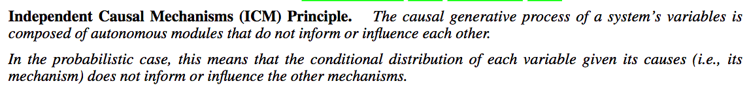
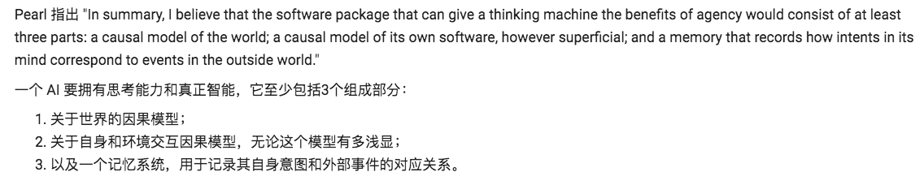
模型理解

Slide 78
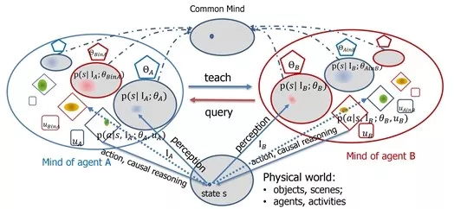
建立在认知构架之上的通讯学习 by 朱纯松
A “model” is an idealized representation of reality that highlights some aspects and ignores others.
Notes:
一个 AI 要拥有思考能力和真正智能，它至少包括3个组成部分：
1. 关于世界的因果模型；
2. 关于自身和环境交互因果模型，无论这个模型有多浅显；
3. 以及一个记忆系统，用于记录其自身意图和外部事件的对应关系。

Slide 79
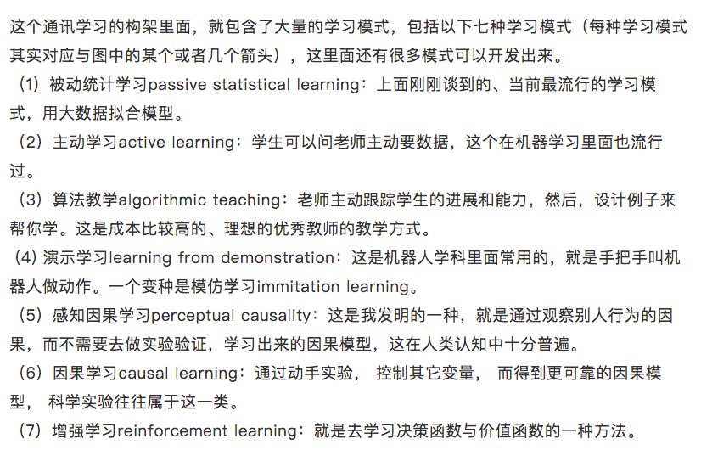
Notes:
Agents 需要具备因果思维，不停和回答三级因果问题，才能进行各种方式的学习。

Slide 80
I expect that going forward, causality will play a major role in taking representation learning to the next level, moving beyond the representation of statistical dependence structures towards models that support intervention, planning, and reasoning, realizing Konrad Lorenz’ notion of thinking as acting in an imagined space. — Bernhard Scholkopf

Slide 81
Heros and Researchers
The way to Intelligence

Slide 82
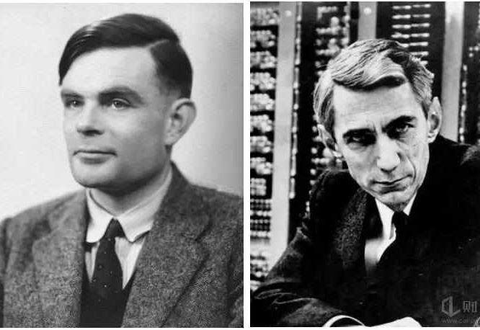
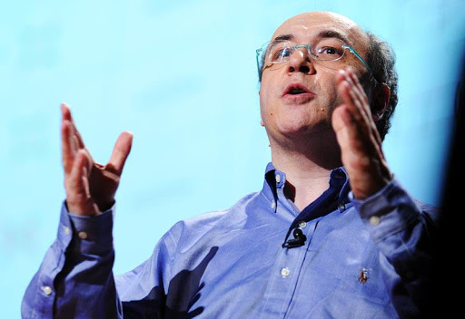
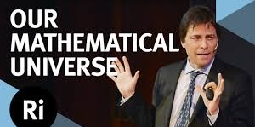
Heros
Stephen Wolfram:
计算万物理论
宇宙是一个演化的超图网络, 超图对应因果不变性原理
Max Tegmark:
Consciousness is a mathematical pattern
Life 3.0: Being Human in the Age of Artificial Intelligence
Notes:
强者的诅咒，Stephen Wolfram VS Yuvari Harare.
小图灵测试是一个中间过程，机器掌握三级因果思维是一个至关重要的环节，但是 system 1 显然是 system 2 的基础。

Slide 83
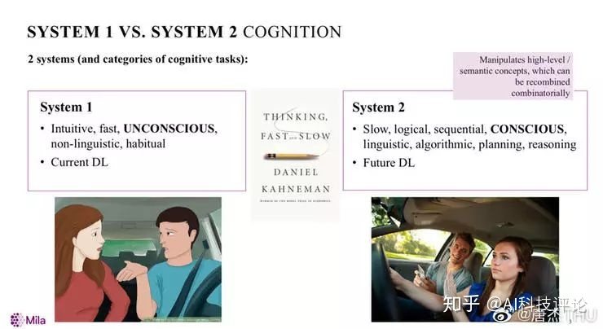
Yoshua Bengio
It is no secret that causality is one of the major shortcomings of current machine learning systems, which are centered around finding and matching patterns in data. Bengio believes that having deep learning systems that can compose and manipulate these named objects and semantic variables will help move us toward AI systems with causal structures.
Notes:
Judea Pearl, Scholkopf, Bengio
因果数学化，我已经比较熟练
Learning disentangled representations，稍微尝试了
Causal Representation Learning，提出了 attention， GAN， 很艰难的在 follow
需要讲解一下 Bengio 和 Bernhard 之间合作的故事。

Slide 84
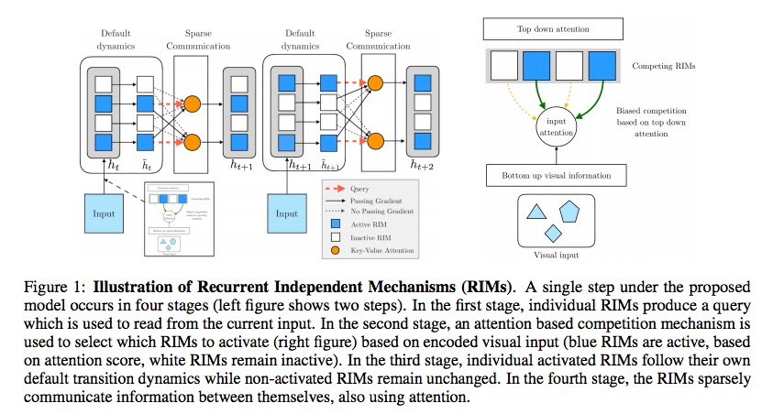
Recurrent independent mechanisms
Notes:
Bengio + Scholkopf
学习出环境动力学的模块化结构表示可以拥有更好的泛化能力，以及对变化（which only affect a few of the underlying causes）的稳健性。 我们提出了循环独立机制（RIMs），这是一种新的循环体系结构 in which
- multiple groups of recurrent cells operate with nearly independent transition dynamics,
- communicate only sparingly through the bottleneck of attention, and
- are only updated at time steps where they are most relevant.
We show that this leads to specialization amongst the RIMs, which in turn allows for dramatically improved generalization **on tasks where some factors of variation differ systematically between training and evaluation.**

Slide 85
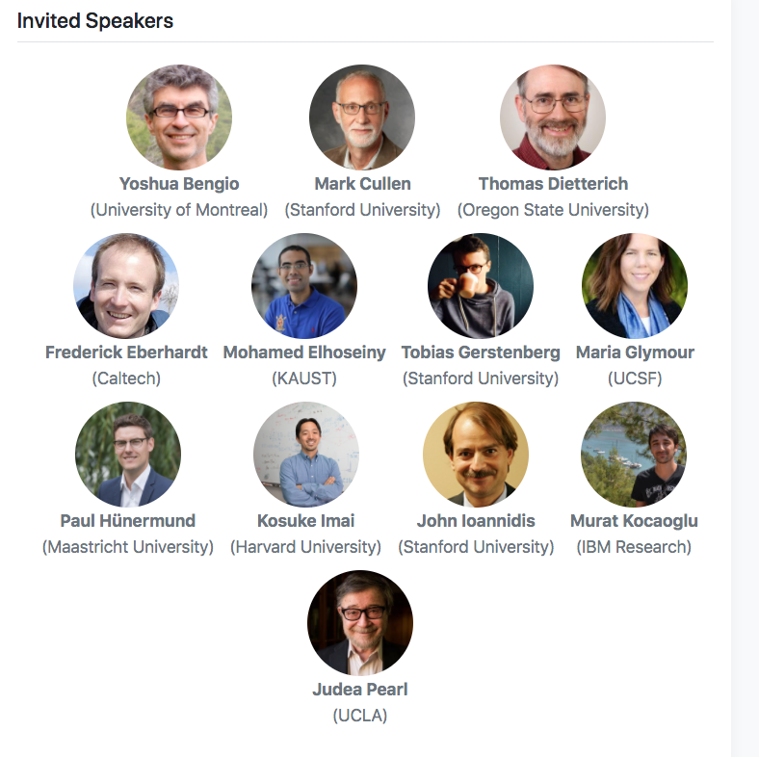

AAAI
Notes:
因果表示学习很关键！可以看到它喜欢用 Pontential Outcome, 因为有环因果问题难以处理。

Slide 86

高中生对 Causal AGI 感兴趣
Notes:
THBI，宋森教授当年也是高中的时候对AGI感兴趣，号称 prolog 大拿。
佩服宋森教授的一点是，大过年都在群里发论文
具备全局视野

Slide 87
其他研究
斯坦福大学李飞飞组的研究者发表论文《CAUSAL INDUCTION FROM VISUAL OBSERVATIONS FOR GOAL DIRECTED TASKS》，为代理建立了元学习算法，以从代理的视觉观察中发现因果关系，并使用此类因果知识执行目标导向的任务。
Gary Marcus, Rebooting AI: Building Artificial Intelligence We Can Trust
朱松纯, Learning perceptual causality from video, 2013
Yu Bin, The Yu Group's research focuses on practice, algorithm, and theory of statistical machine learning and causal inference.
Notes:
我觉得朱老师写的招生问答很实在。能感觉出来他很负责。比如这几句：
“一般来说，如果你的本科不是CS， 如 EE，automation等相关学科，你最好报统计学。”
“如果你本科读的是传统的统计、数学、物理等理科， 基本不适合申请本实验室，除非你能证明很强的编程和实验能力。”

Slide 88
Thank you!
Heyang Gong, zj3712@gmail.com
Related resources will be posted at:
https://heyanggong.github.io/tangjieReport/
See more about Causal AI
https://sites.google.com/view/minituring/home

